Slide 1
First year practicals
Lab 5: Mental Rotation

Slide 2
Measuring Mental Imagery
The concept of mental imagery can be traced back to Galton (1883)
gave a questionnaire to 100 people asking them to remember their breakfast table and answer some questions about the images that they had
With the questionnaire, Galton created a measure of imagery that was related to sex, age, and other differences specific to individuals
The basic findings were that there are striking individual differences in the ability to form mental ‘images’

Slide 3
Dual Coding Hypothesis
Paivio (1971) proposed the Dual-Coding hypothesis
The basic tenet of this theory is that information may be mentally represented either in a verbal system or a nonverbal (analogical) system
Each system contains different kinds of information.
Each concept is connected to other related concepts in the same system and the other system.
Activating any one concept also leads to activation of closely related concepts.

Slide 4
Pictures in the Head
Pylyshyn (1973) argues that whatever a imagery might be, it cannot be a ‘picture in the head’ or a ‘mental photograph’
There would be far to many of them
There no possible means of organising them
Imagery is ‘conceptual’ and must be constructed from a more abstract form
The presence of imagery is epiphenomenal, i.e. not the functional process itself

Slide 5
Experiments on the Rotation of Mental Images
Roger Shepard and his colleagues designed a series of studies that looked at the extent to which people could manipulate their own mental images
Shepard & Metzler (1971)
showed subjects pairs of 3-D line drawings
1600 pairs were generated
In some pairs the second image was a rotation of the first
Some pairs contained two different images
The rotations varied from 0 to 180 degrees

Slide 6
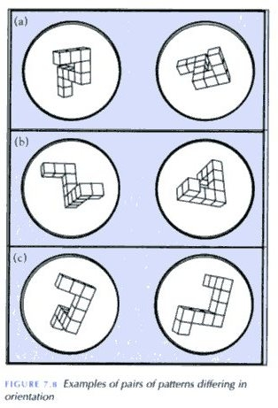
An example pair of stimuli
The picture to the right shows some typical pairs of stimuli taken from Shepard & Metzler (1971)
Science, 171, pp701-703.

Slide 7
Results of the Experiment
The subjects’ task in the experiment was to decide whether the two images were the same or different
The graph on the right shows the time to respond to pairs of stimuli as a function of the difference in degrees between the members of the pair
Response time (s)
0
180
Rotation (deg)

Slide 8
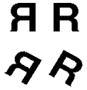
Rotating Letters
Cooper & Shepard (1973) extended the findings by examining whether similar effects could be found when subjects had to recall a particular image
Subjects had to judge whether the letter was ‘normal’ or presented as a ‘mirror’ image
When the letters were rotated the same results were found

Slide 9
Today’s Practical
A replication of Cooper & Shepard’s (1973) experiment using letters
The analysis of the data will look at the correlation between the RT and the angle of rotation
NB It is possible to use Pearson’s coefficient of correlation to examine experimental data, not just data from correlational design!
Response time (s)
0
180
Rotation (deg)

Slide 10
Creating the PsychoPy experiment
There are a number of steps to creating an experiment in PsychoPy:
Setup the way the types of trials and how they differ (in Excel)
Create settings for the monitor and experiment
Setup the timing and structure of each part (Routine) of the experiment
Setup the way that the Routines will be combined in the Flow
To start with, create a folder to save your experiment in and download the 4 image files to be used (*.png files)

Slide 11
Setting up trial types
In most experiments things differ from one trial to another in one or more ways
For PsychoPy you can control these changes using a spreadsheet of ‘Trial Types’
In the spreadsheet;
each row will represent one type of trial that can occur
each column will represent a variable that determines some aspect of the trial (e.g. what image to present, what the ‘correct’ answer is,… )

Slide 12
Creating our ‘trial types’ file
Our study today will use a pair of letters, G and R, that are either reversed (mirrored) or not and are also presented at various angles. These will come from image files.
Subjects will have to hit one of two keys depending on whether they think the letter was reversed
Open a new document in MS Excel and create column titles in the first row with the names;
image, mirrored, orientation, corrAns
When you give names to columns like this you must not use spaces or punctuation. We’ve used a capital A to show that corrAns represents two words

Slide 13
Creating our ‘trial types’ file
In the columns we will insert the following info:
image:
the name of the image file (G.png, revG.png, R.png, revR.png)
reversed:
0 (not reversed) or 1 (reversed)
orientation:
a complete set of 0,10,20,…180 for each of the 4 stimuli
corrAns:
left or right (left cursor when ‘mirrored’ column value =0, right cursor when ‘mirrored’ column value =1)
You should end up with 76 trial types/rows.
First, take your hand off the mouse and watch me do this. You can do it afterwards yourself
Notes:
Demonstrate this while students watch and THEN get them to do it, NOT have them do it along with the lecturer

Slide 14
Creating our ‘trial types’ file
Always check very carefully that the Trial Types file specifies the conditions exactly as you want them. One very common place for mistakes in experiments is when the experimenter has forgotten to update the conditions correctly after copy/paste
Save the file as trialtypes.xlsx (or something else that’s obvious) in the same folder as the experiment

Slide 15
Create a new experiment in PsychoPy Builder
Open PsychoPy, go to the Builder view
Set up the properties of the Experiment by clicking the button marked marked like the diagonal of a screen:
Remember, you can always get a hint about what a button does by hovering the mouse over it

Slide 16
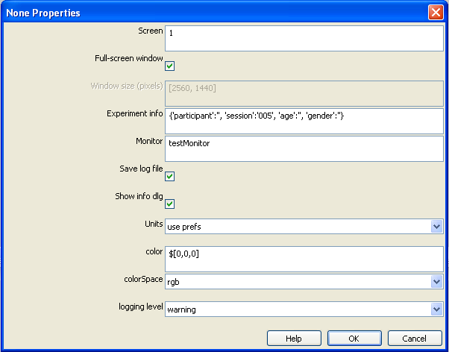
Setting the experiment properties
The dialog that comes up allows you to set various things about the experiment in general, such as the way the stimulus window appears and the dialog that gets info from subjects.
For most dialogs, you can get help on what the settings mean by clicking the help icon.

Slide 17
Setting the experiment properties
In the dialog, one of the settings says ‘Experiment Info’ and another says ‘Show info dlg’
This allows us to present a dialog to subjects and control what gets stored
Let’s add boxes to ask for the subject age and gender, useful for writing the methods section
Set Experiment info to read;
{'participant’:' ', 'session':'005', 'gender':' ', 'age':' '}
Make sure your inverted comma’s match up!
Hit OK to close the dialog

Slide 18
Save your experiment
Save your PsychoPy experiment in the same folder as the trial types file and image files

Slide 19
Creating your trial Routine
Most experiments have several Routines, one of which usually controls a single trial
Timing of events within a Routine is generally very precise
Within a Routine you can have many Components that each control a stimulus, or method of responding etc
Components get added to the Routine by clicking the buttons on the right of the Builder
After being inserted you can edit a Component’s settings by clicking on its name or icon
In our study, we want to have a fixation point, followed by our stimulus, and then give subjects the chance to respond with one of two keys

Slide 20

Adding a fixation point
There are various things we could use to guide our subjects’ fixation. A simple one is to create a cross by presenting subjects with the character ‘+’
Add a Text Component to the trial Routine by hitting the button marked like a pair of Ts (as above)
Give you text object the name fixation
Set its actual text to be simply +
Set its duration to be 0.5 ( for 500ms)
Set color to black
Hit OK
You can always go back and edit the fixation by clicking on its name or icon

Slide 21

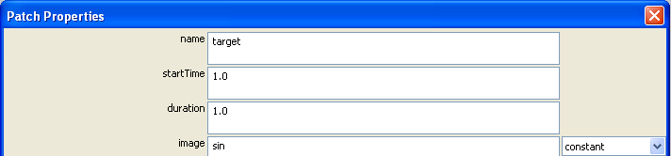
Create the main stimulus
We want to present one of four images, at many orientations, based on parameters in our trial types file
Add a Patch Component (this is usually an image) with the icon above
Set the name of the stimulus to be something that you will remember, and not the same as anything else, e.g. target
Set the Start time for the patch to be 1.0 (seconds) and the duration to 3.0 (seconds)
3.0

Slide 22
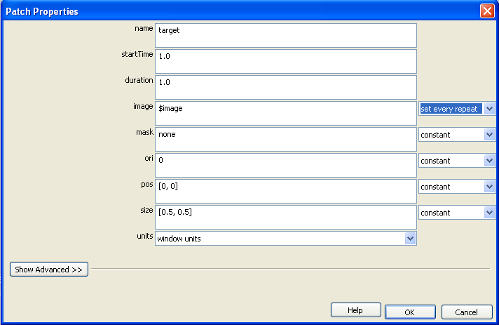
Create the main stimulus
In the trial list we had a parameter called image. We can refer to that here using $
We need the stimulus to change on each repeat (i.e. each trial)

Slide 23
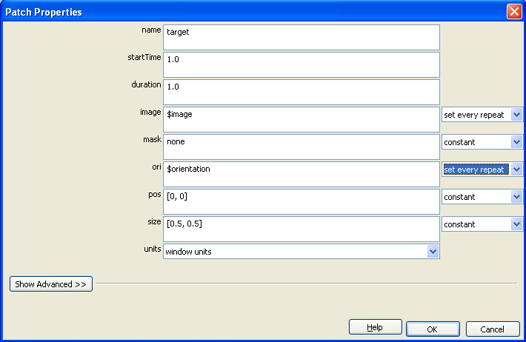
Stimulus Orientation
Stimulus orientation also needs to be set from your file and changes on every repeat of the Routine

Slide 24
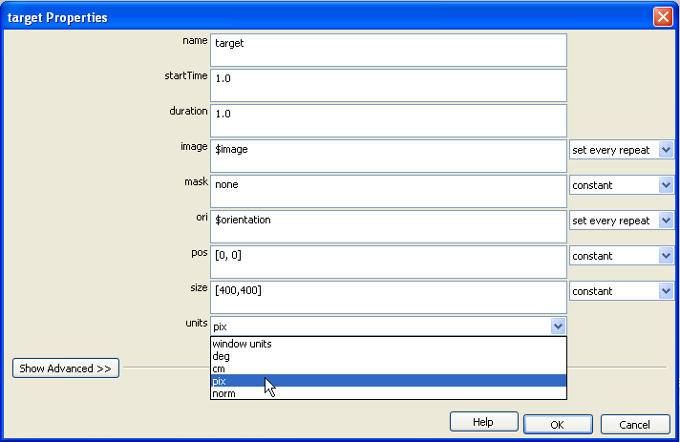
Stimulus size
By default the size of our stimulus is based on fractions of screen (or something like it), and because our screen is not square they will come out looking odd
Let’s make the images a fixed number of pixels in width and height, say, [400,400] and set the units to pix
Then we’re done, so hit OK

Slide 25

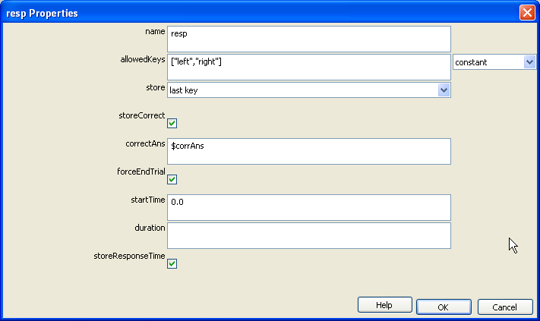
Get a response
To get a response from the subject we usually use the keyboard
Insert it with the keyboard icon
This is already set to use the ‘left’ and ‘right’ keys (the 4 arrows under the return key)

Slide 26
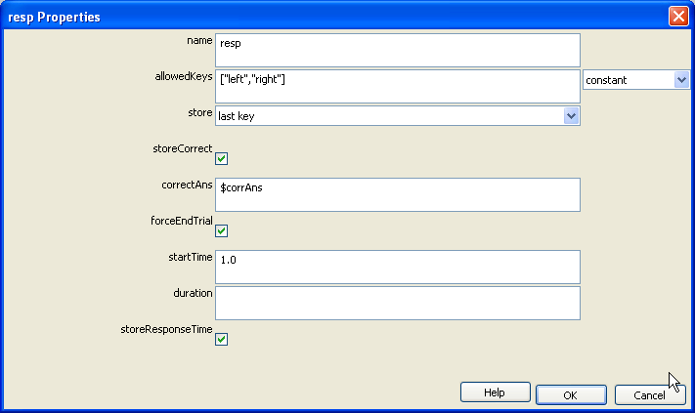
Get a response
We need to tell PsychoPy what the correct answers are. These are stored as corrAns in your file.
Tick the box storeCorrect and set the correctAns to be $corrAns
You can leave duration blank (infinite) but set the start time to be 1.0. We don’t want the subject responding before the stimulus is visible

Slide 27
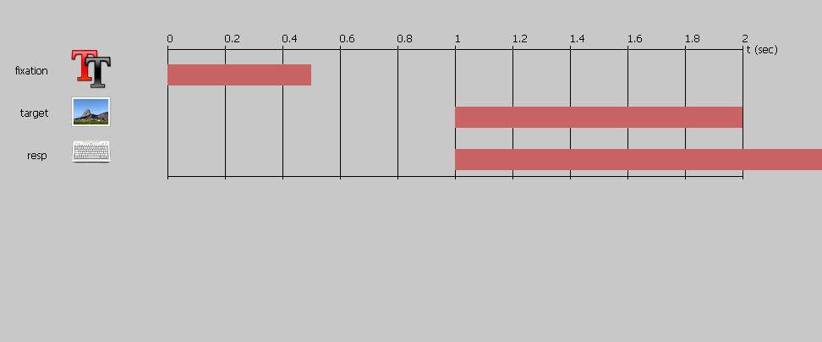
Overview of trial
Your trial should look like this.
Note how the resp time bar goes off the end of the view (to infinite), because it only stops when a key is pressed

Slide 28
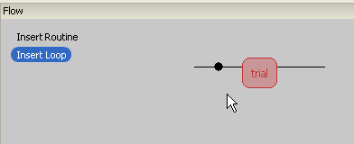
Add a loop to repeat trials
We want the trials to repeat. In the Flow panel (bottom of the Builder view) click the ‘Insert Loop’ button once
An icon will come up showing an insertion point. Click once on each side of the trial box

Slide 29
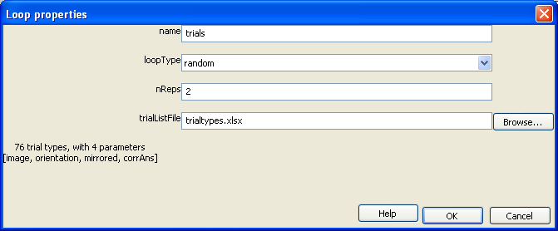
Add a loop to repeat trials
As you select the second endpoint for your loop a dialog appears
Click on the Browse… button select your trial types file (from excel). PsychoPy will summarise how many types of trial there are and how many parameters/variables
Also, set the nReps to 2 (5x76 will take too long!)

Slide 30
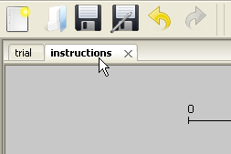
Adding instructions
Let’s add some instructions
For this we need an extra Routine, to be positioned outside the trials loop
From the >Experiment menu select New Routine
Give the new Routine the name instructions
A new tab will appear in the set of Routines, but you may need to select it

Slide 31

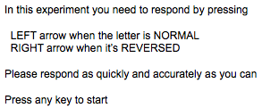
Adding instructions
Insert a new Text Component
Give it the name instrText (we can’t call it instructions because we used that name for the Routine we just created)
Set the duration to be blank (infinite)
Type some instructions into the text field, telling the subject what to do
NB. If you have lots of text you may need to reduce the height of the letters a little
Notes:
In this experiment you need to respond by pressing
LEFT arrow when the letter is NORMAL
RIGHT arrow when it’s REVERSED
Please respond as quickly and accurately as you can
Press any key to start

Slide 32
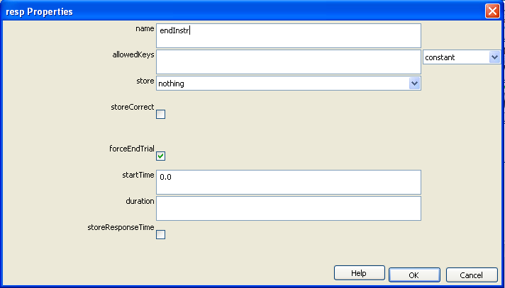
Ending instructions
We told the user to press any key to begin. We better set that up!
Insert a Keyboard Component
Set the name to be endInstr
Set the allowedKeys to be blank so that any key can be pressed
Set the store value to be ‘nothing’
Also uncheck the storeResponseTime setting at the bottom:
Hit OK

Slide 33
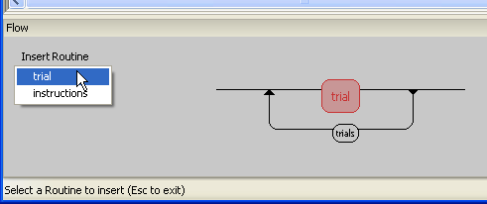
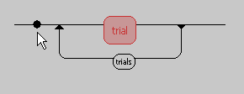
Inserting instructions
Now we need to add that Routine to the Flow
In the Flow panel press (once) the Insert Routine button
Select the Routine you want to insert
…and then the place you want to insert it
NB. If you insert your Loop or Routine in the wrong place you can right-click it and ‘remove’

Slide 34
Copy/paste a Routine
You could also add a thank you/goodbye message (that encourages subjects to leave once you’re finished!)
That’s going to be very similar to your instructions Routine
Make sure your instructions Routine is selected and go to >Experiment>Copy Routine
Then select >Experiment>Paste Routine
This is particularly handy for long/complex routines, and it can be done between different experiments too – but then you may need to make sure that the variables have the same names!
Notes:
You could try going to one of the previous studies and copying the Feedback Routine, and pasting it into this experiment.
If it’s inserted into the flow, immediately after the trial it should work here too.

Slide 35
Alter your goodbye message
In your goodbye Routine, you need to;
Rename the instrText Component to be called something new (e.g. thanksText)
Give it some new text (obviously!)
Rename the Keyboard Component too

Slide 36
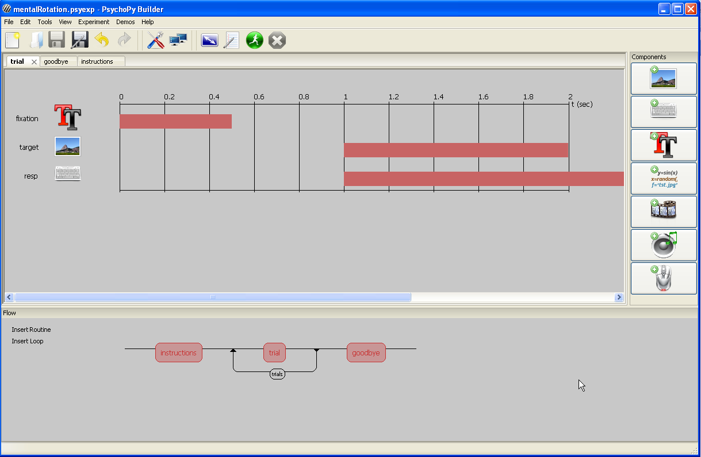
The end product
Remember to save!

